Slide 1
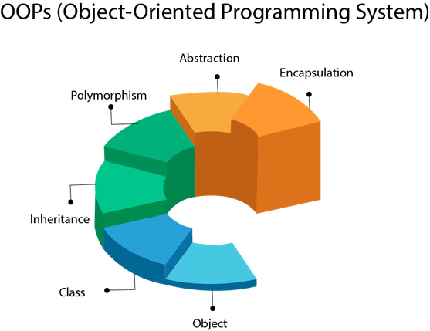
What is OOP ?
Object-Oriented Programming(OOP), is all about creating “objects”. An object is a group of interrelated variables and functions. These variables are often referred to as properties of the object and functions are referred to as the behavior of the objects. These objects provide a better and clear structure for the program.
OOP focuses on the objects that are required to be manipulated instead of logic.
It makes development and maintenance easier
It provides data hiding (By Encapsulation)
It provides ability to simulate real-world
Less memory Usage and organized
- Reusable ) By Inheritance / Composition)

Slide 2
Object-Oriented Programming (OOP) vs Procedure Oriented Programming (POP)
One way to think about POP is the same way you make lemonade for example. The procedure of making lemonade involves- first taking water according to the need, then adding sugar to the water, then adding lemon juice to the mixture, and finally mixing the whole solution. And your lemonade is ready to serve. In a similar way, POP requires a certain procedure of steps. A procedural program consists of functions. This means that in the POP approach the program is divided into functions, which are specific to different tasks. These functions are arranged in a specific sequence and the control of the program flows sequentially. Whereas an OOP program consists of objects. The object-Oriented approach divides the program into objects. And these objects are the entities that bundle up the properties and the behavior of the real-world objects.
POP is suitable for small tasks only. Because as the length of the program increases, the complexity of the code also increases. And it ends up becoming a web of functions. Also, it becomes hard to debug. OOP solves this problem with the help of a clearer and less complex structure. It allows code re-usability in the form of inheritance.
Another important thing is that in procedure-oriented programming all the functions have access to all the data, which implies a lack of security. Suppose you want to secure the credentials or any other critical information from the world. Then the procedural approach fails to provide you that security. For this OOP helps you with one of its amazing functionality known as Encapsulation, which allows us to hide data. Don’t worry I’ll cover this in detail in the latter part of this article along with other concepts of Object-Oriented Programming. For now, just understand that OOP enables security and POP does not.

Slide 3
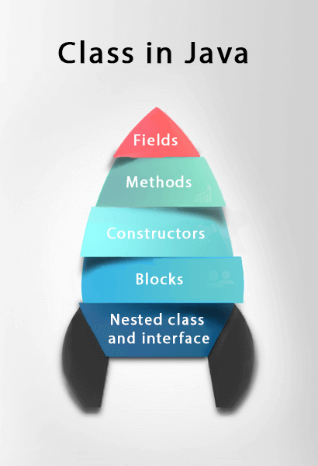
What is a Class?
A class is a collection of objects which have common properties. Unlike the primitive data structures, classes are data structures that the user defines. They make the code more manageable.
Class is a template or blueprint from which objects are created. It is a logical entity. It can't be physical. It is a construct that define objects of the same type.
A variable which is created inside the class but outside the method is known as an instance variable. Instance variable doesn't get memory at compile time. It gets memory at runtime when an object or instance is created. That is why it is known as an instance variable.
What Is Constructors?
A special method with no return type used for object creation to initialize object variables.
And It a Code that gets executed when 'new' is called.
Default constructor is a constructor without any parameter ,and if there isn’t any constructor in a class then JRE generates the default automatically at runtime.
Its name is same as the class name, Can be any access modifier and takes whatever parameters , but can’t have any return type even void.

Slide 4
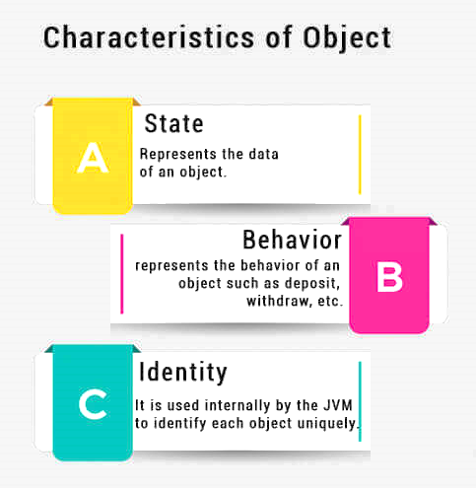
What is an Object?
An entity that has state and behavior is known as an object. An object has three characteristics as in the figure.
State (properties / Attributes) : represents the data (value) of an object.
Behavior: represents the behavior (functionality) of an object such as deposit, withdraw, etc.
Identity: An object identity is typically implemented via a unique ID. The value of the ID is not visible to the external user. However, it is used internally by the JVM to identify each object uniquely.
(Attributes)
For Example, Pen is an object. Its name is Reynolds; color is white, known as its state. It is used to write, so writing is its behavior.
An object is an instance of a class. A class is a template or blueprint from which objects are created. So, an object is the instance(result) of a class.
Object Definitions:
An object is a real-world entity.
An object is a runtime entity.
The object is an entity which has state and behavior.
The object is an instance of a class.
The new keyword is used to allocate memory at runtime. All objects get memory in Heap memory area.

Slide 5
What Is Static?
Static variables are shared by all the instances of the class.
Static methods are not tied to a specific object.
Constant variables is static with final keyword which shared by all the instances of the class.
Preferred to access static variable through static method .
It takes a single place in the memory, stored at heap to stay till the end, it is general to be accessible from any object so, it's preferred to make const static and final.
Static Variables could used in Instance Method in addition to Static Methods ,While Instance Variable Could only used in Instance Method (Because it needs object while static doesn't need object).
Static Method can’t call Instance Method While Instance Method can call Static Method (For the same reason above).
Remember That the main Method is the type of Static.
Any change in static variable affect in all objects related to it.
The only way to call an Instance Method in a Static Method is by making an object from the class and using the instance method through it.

Slide 6
Concrete Vs Contract
What Is a Concrete Class?
A concrete class is a class that we can create an instance of, using the new keyword. In other words, it's a full implementation of its blueprint.
So, if it isn’t full implementation, it is an abstract class.
What Is an Interface?
an interface is a group of related methods with empty bodies.
Interfaces form a contract between the class and the outside world, and this contract is enforced at build time by the compiler. If your class claims to implement an interface, all methods defined by that interface must appear in its source code before the class will successfully compile.
Implementing an interface allows a class to become more formal about the behavior it promises to provide.
What Is Abstract Class?
A Class Doesn’t have a full Implementation.
A method defined abstract must always be redefined in the subclass.
An abstract class can have parametrized constructors (default constructor is always present).
Abstract class can not be directly instantiated using the new keyword.
An abstract method is a method without an implementation.

Slide 7
When to use Abstract class & Interface?
Abstract Class :
You want to share code among several closely related classes (expect an extend to the Abstract class).
You want to define state that is non static or non final fields.
there are large functionalities.
Interfaces :
You need to add a dynamic behavior for different unrelated classes.
You want to specify a contract, but not concerned about who implements its behavior.
You want to take advantage of multiple inheritances.
All states (Attributes) are Public Final Static (Used for Const Variables).
there are small functionalities.

Slide 8
OOP language follows 4 principles:
1-ENCAPSULATION: Binding (or wrapping) code and data together into a single unit, We can hide direct access to data by using private keyword and we can access private data by using getter and setter methods. in my framework I have POJO class which I use it when we need to represent some data as Java object. So, to that we need to create a Java class to represent it's data. So, in POJO class I use encapsulation and getter setter method to access them.
2-ABSTRACTION: It is a process of hiding implementation details and showing only functionality to the user. Abstraction lets you focus on what the object does instead of how it does it. For example, phone call, we don't know the internal processing. In Java, we use abstract class and interface to achieve abstraction.
3-INHERITANCE: It is used to define the relationship between two classes (is-a relation). When a child class acquires all properties and behaviors of parent class known as inheritance. Child class can reuse all the codes written in parent class. It provides the code reusability, also used to achieve runtime polymorphism (Overriding), it is a mechanism in which one object acquires all the properties and behaviors of the parent object.. in my framework I have a TestBase class which I store all my reusable code and methods. My test execution classes, and elements classes will extend the TestBase in order to reuse the code.
4-POLYMORPHISM: It is an ability of object to behave in multiple form Based on the current context. The most common use of polymorphism is Java, when a parent class reference type of variable is used to refer to a child class object. I use polymorphism almost everywhere. For example, if we have Animal class Contains speak method, we inherit them to Dog, Cat classes, the dog object will return the "woof" to the speak method and the cat will "meow" in the same method we call. It Achieves by applying Method Overloading and Overriding.

Slide 9
some other concepts which are used in Object-Oriented design
Coupling:
It refers to the knowledge or information or dependency of another class. It arises when classes are aware of each other. If a class has the details information of another class, there is strong coupling. In Java, we use private, protected, and public modifiers to display the visibility level of a class, method, and field. You can use interfaces for the weaker coupling because there is no concrete implementation.
Cohesion
It refers to the level of a component which performs a single well-defined task. A single well-defined task is done by a highly cohesive method. The weakly cohesive method will split the task into separate parts. The java.io package is a highly cohesive package because it has I/O related classes and interface. However, the java.util package is a weakly cohesive package because it has unrelated classes and interfaces.
Association
It represents the relationship between the objects (two separate classes). Here, one object can be associated with one object or many objects. There can be four types of association between the objects:
One to One
One to Many
Many to One
Many to Many
Let's understand the relationship with real-time examples. For example, One country can have one prime minister (one to one), and a prime minister can have many ministers (one to many). Also, many MP's can have one prime minister (many to one), and many ministers can have many departments (many to many).
Association can be unidirectional or bidirectional.

Slide 10
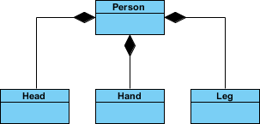
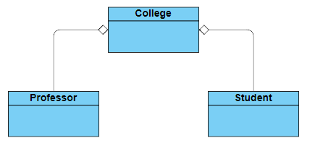
Aggregation
It implies a relationship where the child can exist independently of the parent. represents the weak relationship between objects. It is also termed as a Has-a relationship in Java. Like, inheritance represents the is-a relationship. It is another way to reuse objects. If you delete the parent object , the used object will not be deleted.
Composition
It implies a relationship where the child cannot exist independent of the parent. There is a strong relationship between the containing object and the dependent object . It is also termed as a Part-of
relationship in Java. If you delete the parent object, all the child objects will be deleted automatically.
When there is a composition between two entities, the composed object cannot exist without the other entity (an object Declared in the class of another object).
Aggregation and Composition are subsets of association meaning they are specific cases of association; both are a way to achieve Association where they are represent the relationship in which one object contains other objects as a part of its state(Uses).
Composition
Aggregation

Slide 11
Stack VS Heap
Whenever an object is created, it’s always stored in the Heap space, and stack memory contains the reference to it.
Stack memory only contains local primitive variables and reference variables to objects in heap space.
Objects stored in the heap are globally accessible whereas stack memory can’t be accessed by other threads.
Memory management in the stack is done in a LIFO manner, whereas it’s more complex in Heap memory because it’s used globally.
Stack memory is short-lived whereas heap memory lives from the start till the end of application execution.
Heap memory is used by all the parts of the application, stack memory is used only by one thread of execution.
When stack memory is full, Java runtime throws java.lang.StackOverFlowError When heap memory is full, it throws java.lang.OutOfMemoryError: Java Heap Space error.
Stack memory is faster than heap memory.

Slide 12
Some Useful Concepts
GARBAGE COLLECTION: If an object is not referenced, then The Garbage Collector Automatically frees an object, to prevent memory leaks.
Inheritance Hell: Bad use of the principle of heredity to achieve reusability with no relation between the inherited classes.
Fail Fast principle : stands for stopping the current operation as soon as any unexpected error occurs.
Single inheritance : the subclass is derived from a single.
Multiple inheritance : the subclass is derived from more than one.
Hash Collision: is a situation where two or more key objects produce the same final hash value and hence point to the same bucket location or array index.
POJO: It stands for Plain old Java Object and basically, we use it when we need to represent some data as Java object. So, to that we need to create a Java class to represent its data.
DRY (Don’t Repeat Yourself) Principle: don’t write the same code repeatedly.
Notes:
See
https://enterprisecraftsmanship.com/posts/fail-fast-principle/
https://www.baeldung.com/java-hashmap-advanced
https://www.geeksforgeeks.org/dry-dont-repeat-yourself-principle-in-java-with-examples/

Slide 13
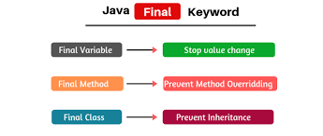
Overloading Vs Overriding
Method Overloading : Multiple methods share the same method name, but different method signature at the same class (access modifiers don't make a difference).
- is an example of compiler time polymorphism (static binding, early binding).
Method Overriding : same method name and same parameter (same signature), occur in different class that has inheritance relationship.
- Access modifiers can only be elevated , must have same return type.
- is an example of run time polymorphism (dynamic binding, late binding).
Static Method can’t be overridden but can hides.
Constructor can’t be overridden.

Slide 14
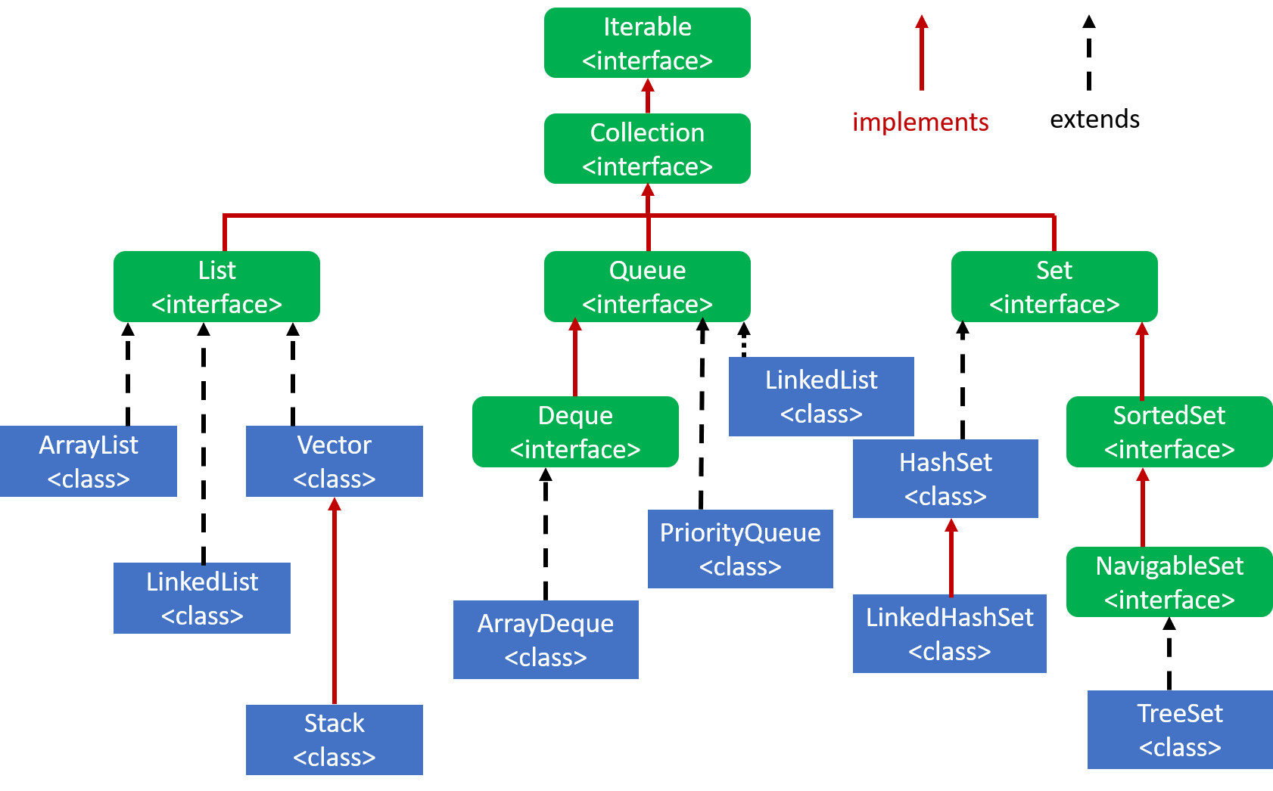
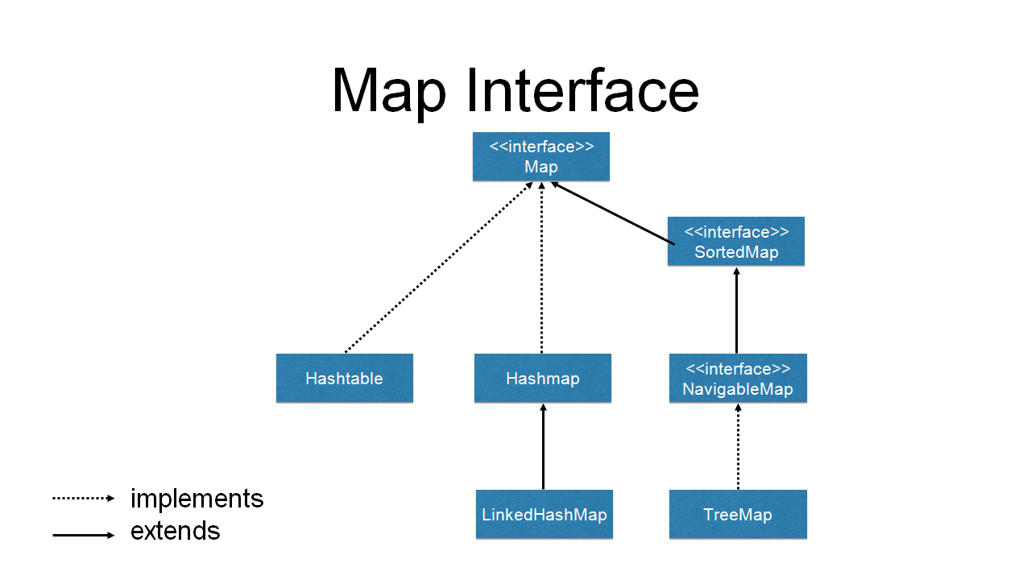
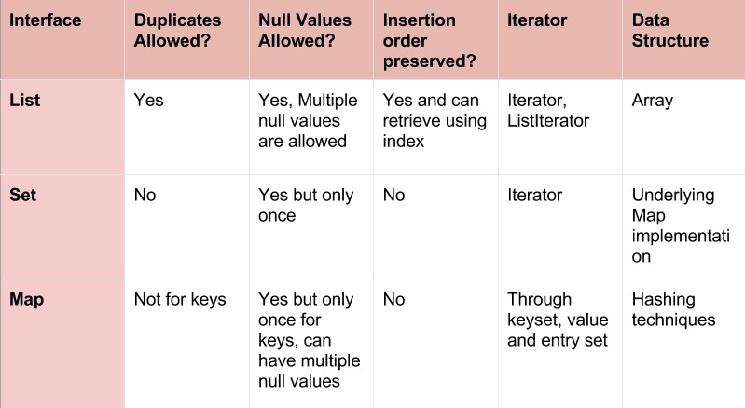
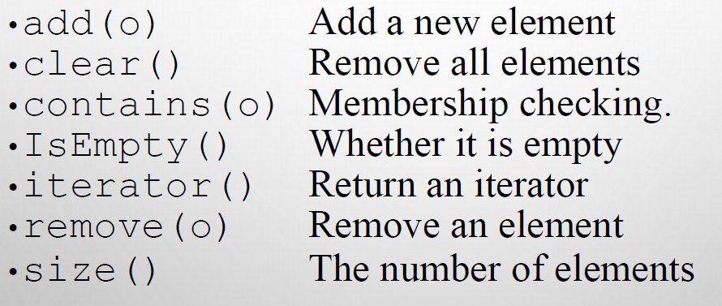
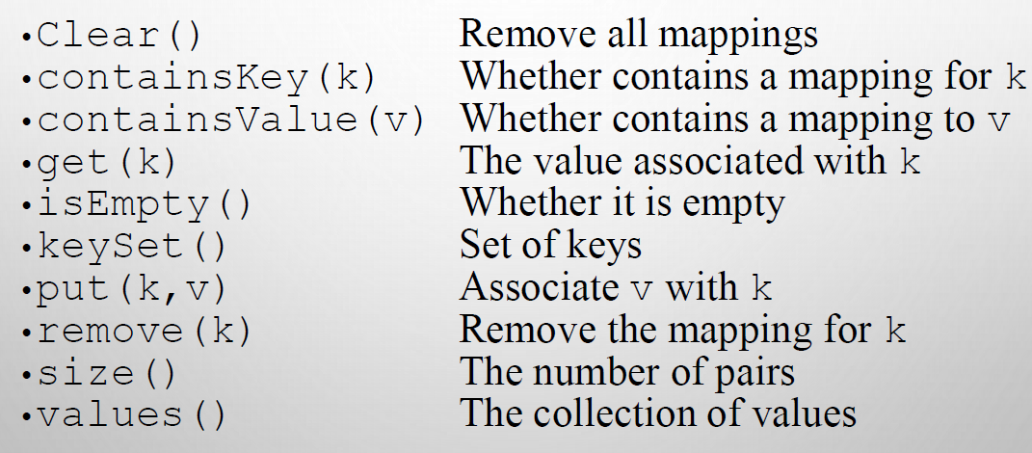
Collection Framework and Map
Collection Methods
Map Methods

Slide 15
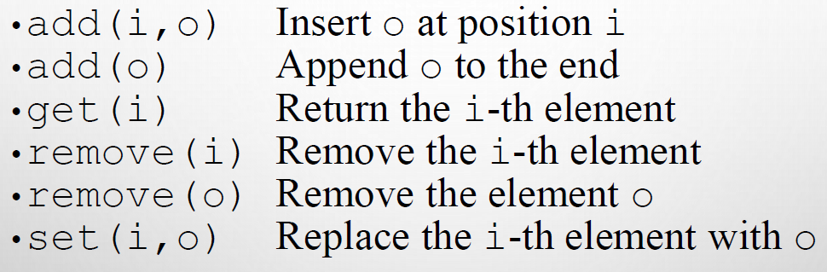
Object Class
List Methods
Access Modifiers
Object class is the parent of all classes (The Most Super Class).
Object Important Methods to be Overridden:
𝑡𝑜𝑆𝑡𝑟𝑖𝑛𝑔() : returns the string representation of this object.
ℎ𝑎𝑠ℎ𝐶𝑜𝑑𝑒() : returns the hashcode number for this object.
𝐸𝑞𝑢𝑎𝑙𝑠() : compares the given object to this object.

Slide 16
Generics
A language feature that enables parameterized type definition.
The Java compiler uses a technique called type erasure to translate generic classes into executable code.
Type safe checking & fail fast in compile time.
Generic programming: means writing code that can be reused for object of many different types.
Generics make the code safer and easier to read.
Type variable are introduced after class name, enclosed by angle brackets < > (Can be Any Letter) , It is common to use upper case letters for type variables.
A type variables is instantiated by substituting types.
methods can be defined as generics (by stands behind method’s return type) and make the return type a generic type or use it in parameters.
You can Restriction of a type variable to a class that is a subtype of another type (By using extends with Type and it can be multiple bounds (At most one bound can be a class)).
Type variables are erased and replaced with bounding variables or Object types if it ain’t any.
No new class are created for parametrized types.
Type Parameters Cannot Be Instantiated with Primitive Types.
You Cannot Create Arrays of Parameterized Types.
Type Variables Are Not Valid in Static Contexts of Generic Classes.
You Cannot Throw or Catch Instances of a Generic Class.
There is No Relation between Generic classes with different types passed (even if the types are related each is independent).
The raw type is to scape passing the Type in <>, when you declare a generic class (Should avoid).
Generic classes can extend or implement other generic types (With the same Type)

